Slide 4

Using Conda

Slide 5
What is conda and why use it?
Control over your package versions and environments
Separate different projects from each other that may need different packages and versions
Ensure consistency over different computers

Slide 6
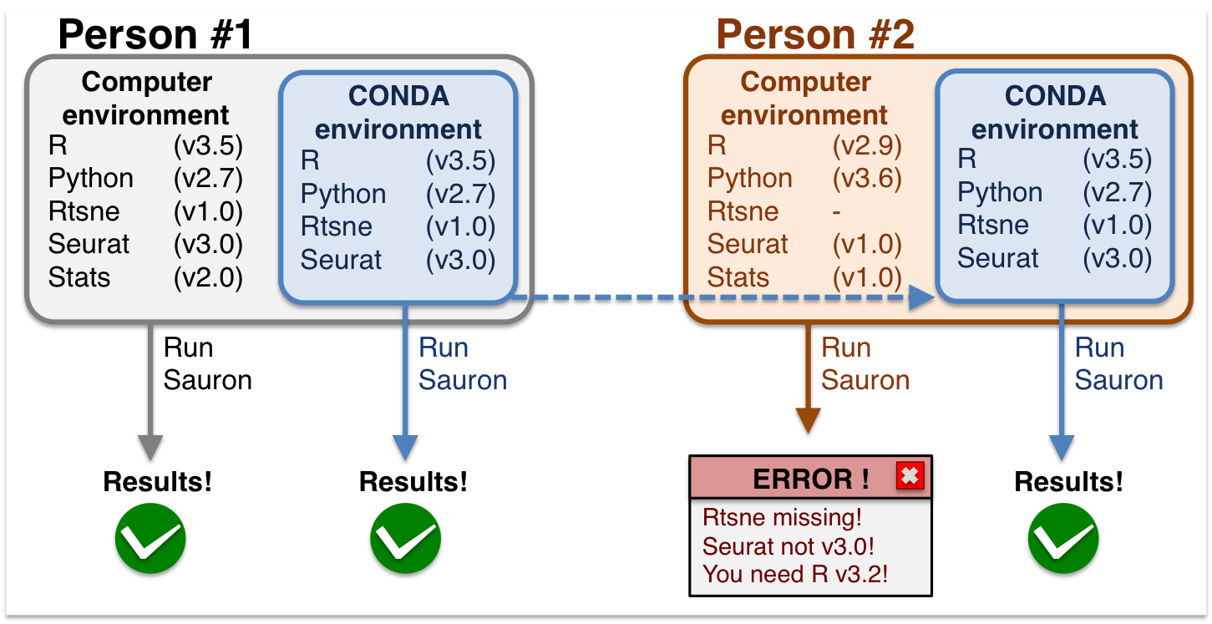
What is conda and why use it?

Slide 7
Basic conda commands
Create a new environment: conda create –n memes python=3.11
Activate the environment: conda activate memes
Deactivate environment: conda deactivate
Create and install packages from yaml file: conda env create -f environment.yml
Install requirements: pip install -r requirements.txt
Create env.yml file: conda env export --name myenv > environment.yml

Slide 8
Try it out yourself
Create a fork of: https://github.com/kthcloud/Computer-Science-Workshop/
Clone the repo to your local computer
Install the conda environment specified in env.yaml
Create a new environment with your name and install the requirements file
Remove the environments

